Slide 1

Group “A”
To Eng: Abdullah Mostafa

Slide 2
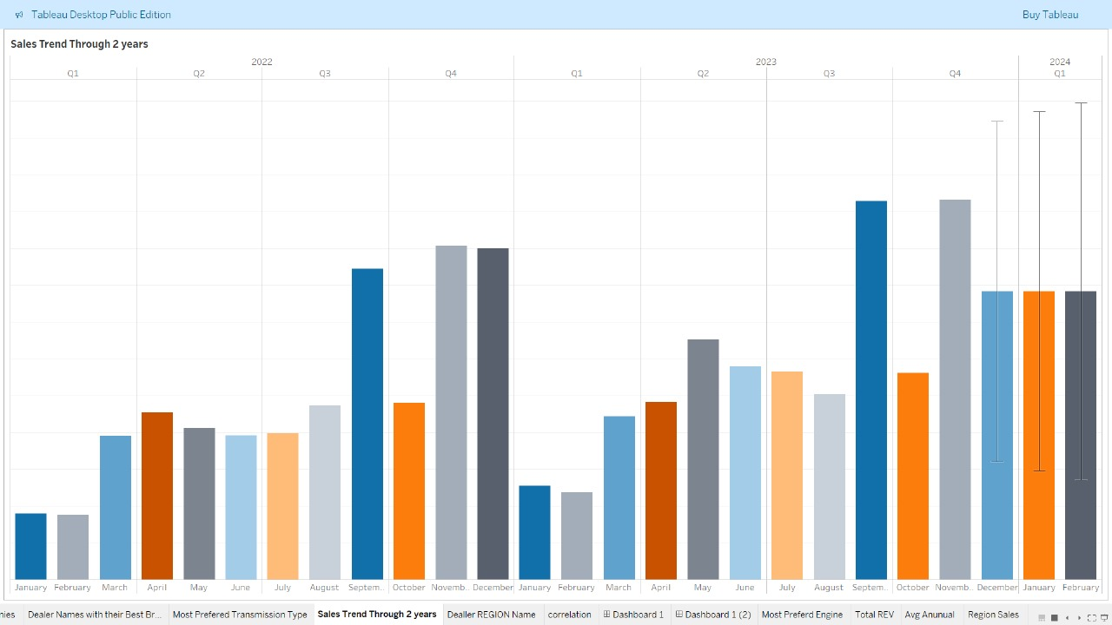
Notes:
Nancy ElOkdah

Slide 3
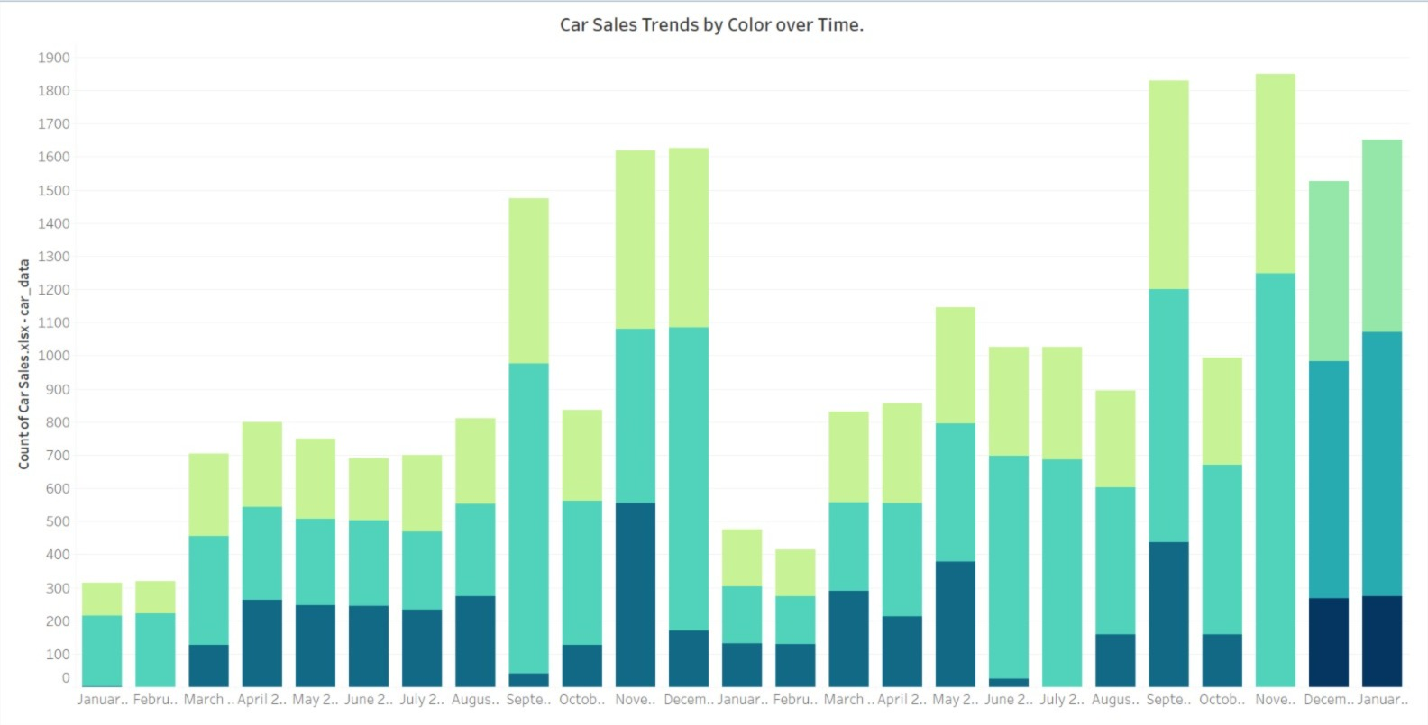
Notes:
Ahmed Mansour

Slide 4
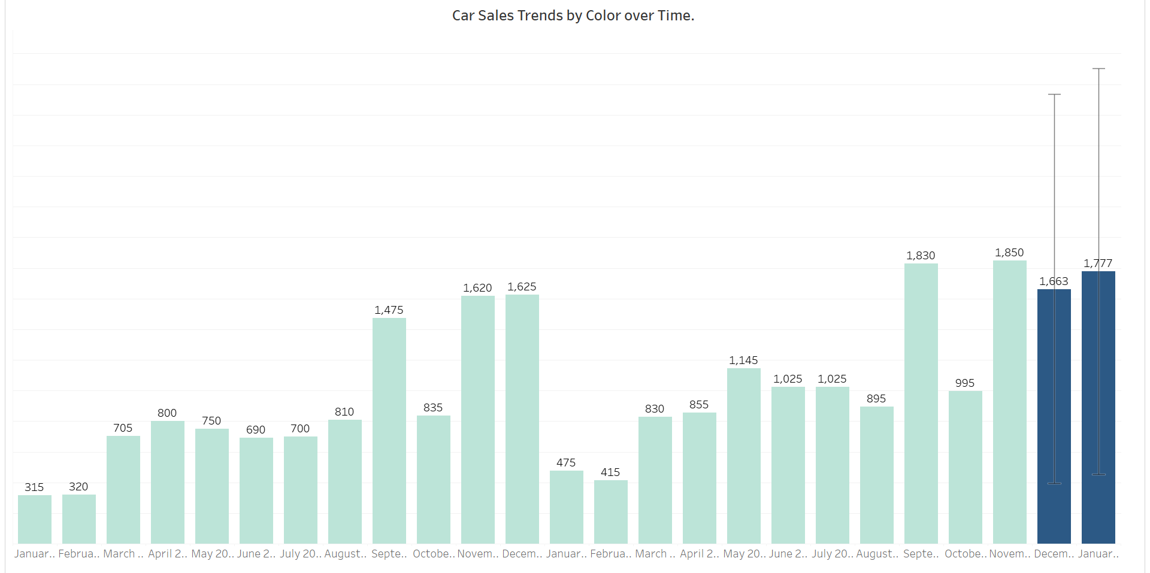
Notes:
Mahmoud Elwakeel

Slide 5
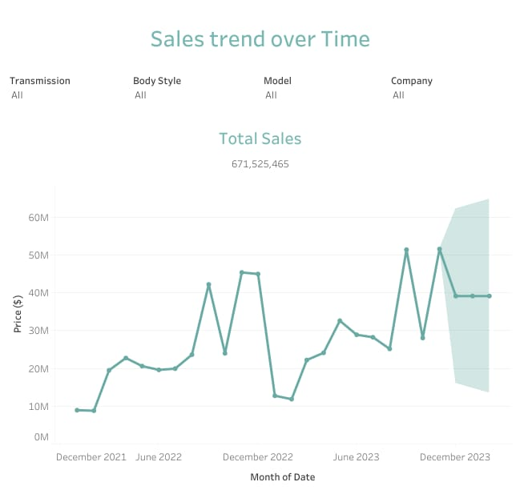
Notes:
Passant Ali

Slide 6
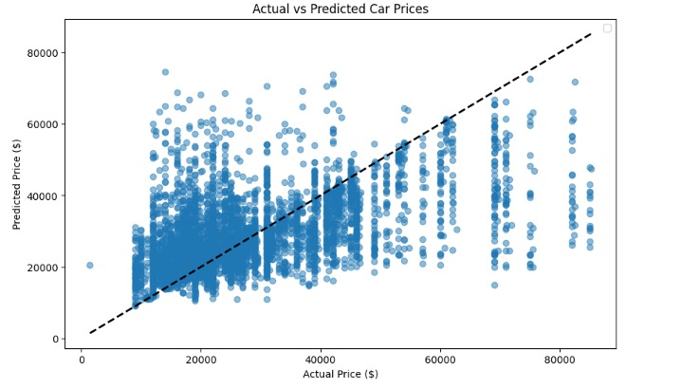
Notes:
Hager Ayman

